Slide 1
MeAsurement of F₂^{n}/F₂^{p}, d/u RAtios and A=3 EMC Effect in Deep Inelastic Electron Scattering Off the Tritium and Helium MirrOr Nuclei
JLab MARATHON Experiment - Update
Tyler Hague
Kent State University
for the JLab MARATHON Collaboration
JLab Hall A/C Collaboration Meeting
June 2017
Work supported by : NSF Grant PHY-1405814 DOE Contract DE-AC05-06OR23177

Slide 2
Overview and Goals of the Experiment
MARATHON will measure the cross section ratio of deep inelastic electron scattering from the 3H and 3He mirror nuclei using the Hall A two HRS system of JLab.
The ratio will determine the ratio of the neutron to proton structure functions (F₂^{n} / F₂^{p})and the ratio of the proton quark distribution functions (d/u) using a new novel method that exploits the isospin symmetry of the A=3 nuclei.
Experiment will also measure the EMC effect for 3H and 3He. A=3 EMC data are considered crucial for the effect understanding.

Slide 3
F₂^{n}/ F₂^{p}, d/u Ratios and A₁ Limits for x→1
 | F₂^{n}/F₂^{p} | d/u | A₁^{n} | A₁^{p}
SU(6) | 2/3 | 1/2 | 0 | 5/9
Diquark/Feynman | 1/4 | 0 | 1 | 1
Quark Model/Isgur | 1/4 | 0 | 1 | 1
Perturbative QCD | 3/7 | 1/5 | 1 | 1
Quark Counting Rules | 3/7 | 1/5 | 1 | 1
A₁: Asymmetry measured with polarized electrons and nucleons. QPM probability that the quark spins are aligned with the nucleon spin.
A₁^{p}, A₁^{n}: Extensive experimental programs at CERN, SLAC, DESY and JLab (6 GeV and 12 GeV Programs)

Slide 4
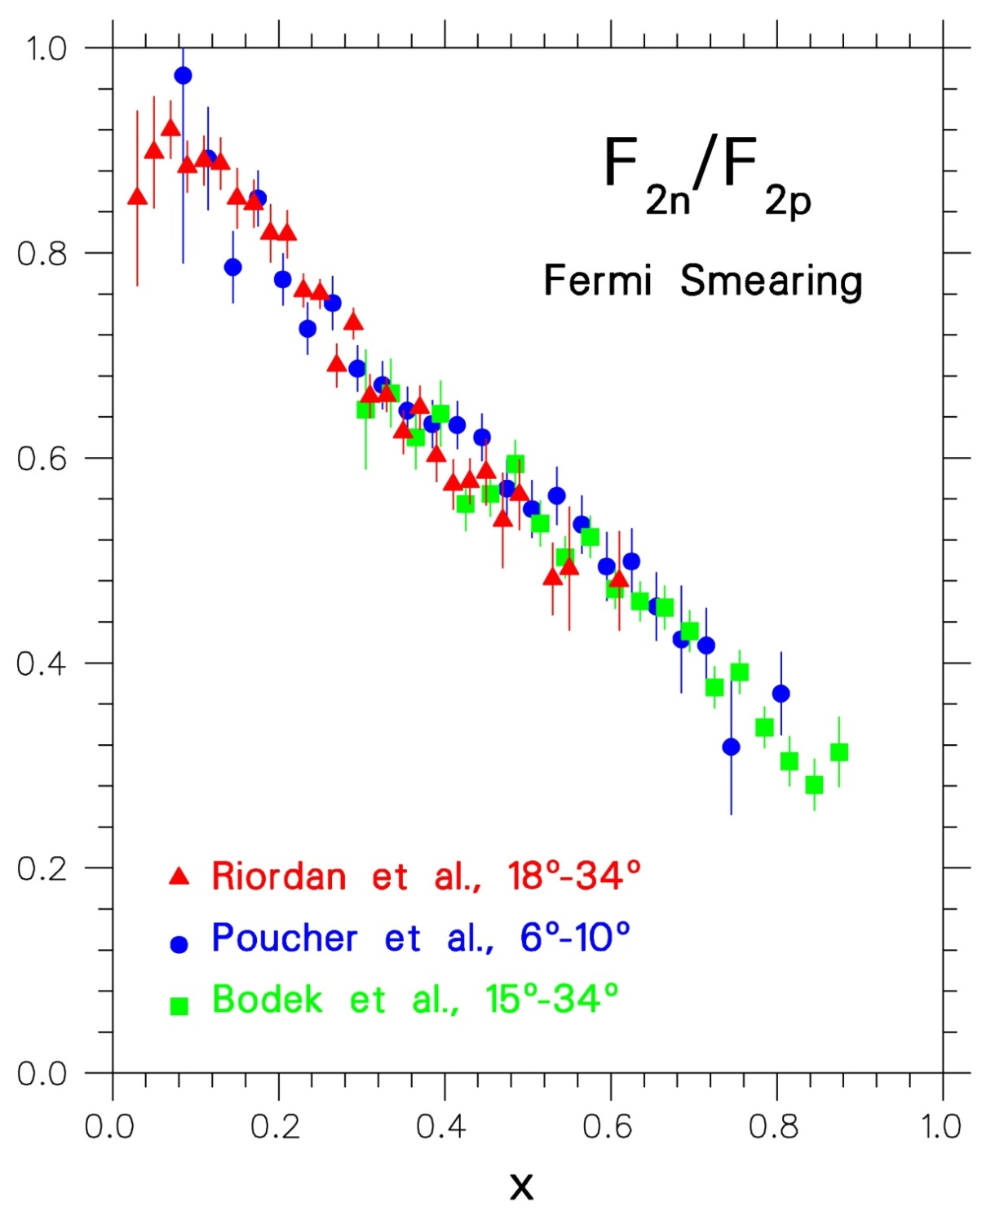
SLAC 1968-1972
Friedman, Kendall, Taylor
Nobel 1991
F₂^{n}/F₂^{p} extracted from p and d DIS
using a Fermi-smearing model and a non-relativistic N-N potential
Data in disagreement with
SU(6) prediction: 2/3=0.67!
High momentum quarks in
p(n) are u(d) valence quarks
There are no high momentum strange quarks in p and n
Sea quarks dominate at small x
Data consistent with di-quark model by Feynman and others

Slide 5
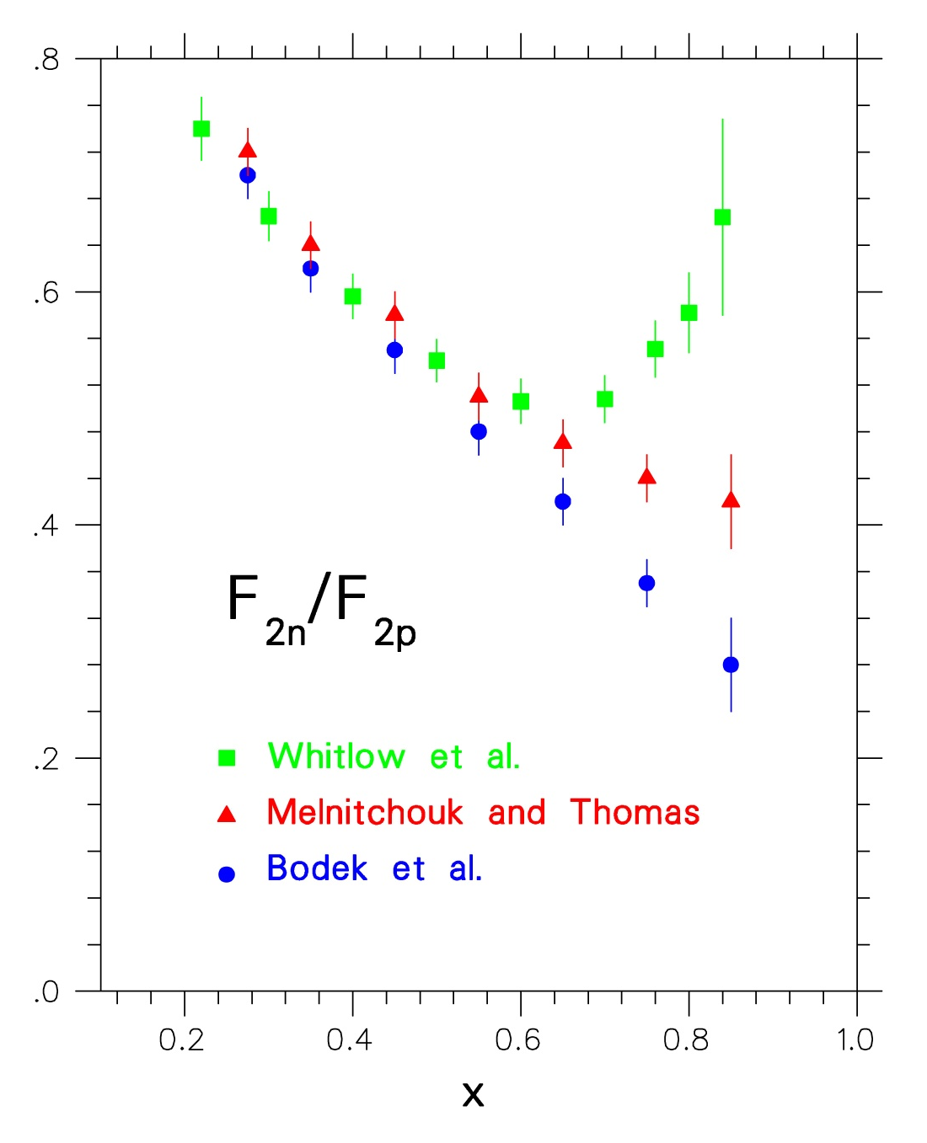
Nucleon F₂ Ratio Extraction Revisited
SLAC DIS Data
Whitlow: Assumes EMC effect in deuteron (Frankfurt and Strikman data-based Density Model)
Melnitchouk &Thomas: Relativistic convolution model with empirical
binding effects
Bodek: Non-relativistic
Fermi-smearing-only model with Paris N-N potential

Slide 6
Deep Inelastic Scattering and Quark Parton Model
DIS cross section - Nucleon structure functions F₁ and F₂:
QPM interpretation in terms of quark momentum probability distributions q_{i}(x) (large Q² and ν, fixed x):
Bjorken x: fraction of nucleon momentum carried by
struck quark:

Slide 7
Nucleon F₂ Ratio Extraction from ³He/³H
Just perform DIS from ³He and ³H. Binding of nucleons in the two nuclei is of same nature. Differences between bound and free nucleons in the two nuclei is calculable, summarized, for their ratio, by some parameter R*
If R=σ_{L}/ σ_{T} is the same for ³He and ³H, measured DIS cross section ratio must be equal to the F₂ structure function ratio as calculated using R*:
Determine nucleon F₂ ratio using A=3 DIS cross section data and R*(≈1) from theory:

Slide 8
R* has been calculated by three expert groups to deviate from 1 only up to ~1.5% taking into account all possible effects:
* I. Afnan et al., Phys. Lett. B493, 36 (2000); Phys. Rev. C68, 035201 (2003)
* E. Pace, G Salme, S. Scopetta, A. Kievsky, Phys. Rev. C64, 055203 (2001)
* M. Sargsian, S. Simula, M. Strikman, Phys. Rev. C66, 024001 (2002)
The new data will be almost free of nuclear structure theoretical uncertainties that dominate the previous SLAC data, extracted from proton and deuteron deep inelastic scattering (DIS) measurements

Slide 9
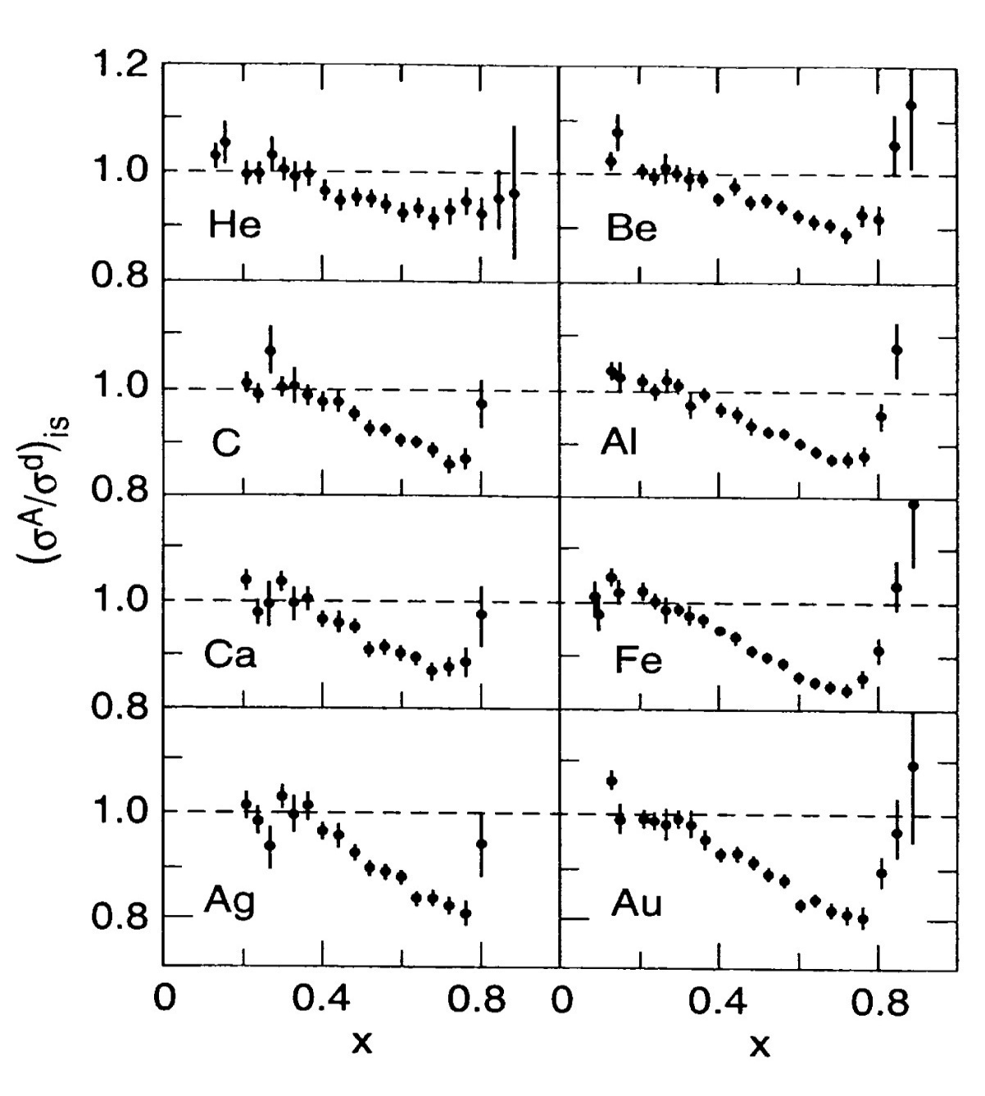
A dependence
EMC Effect
Nucleon momentum probability distributions in nuclei is different from those in deuterium.
Effect increases with mass number A.
No universally accepted theory for the effect explanation.
A=3 data will be pivotal for understanding the EMC effect.
Ratio of EMC effect for ³H and ³He is the best quantity for quantitative check of the theory, free of most uncertainties.
SLAC E-139, 1984
J. Gomez et al.

Slide 10
Experimental Plan and Requirements (I)
After a successful spring 2010 target safety and design review, ³He/³H Hall A MARATHON proposal was fully approved in January 2011 to run for 42 days @100% efficiency.
Proposal was based on the Left High Resolution Spectrometer (HRS) for low-x measurements and the Big Bite Spectrometer (BBS) for high-x measurements.
Kent State students worked with Hall A staff and other students, starting in the summer of 2014, on the refurbishment and reassembly of the BBS detectors, electronics and data acquisition systems
Change of plans after successful final target safety review that took place in the fall of 2015!

Slide 11
Experimental Plan and Requirements (II)
For safety reasons, the target review committee had to impose: i) severe restrictions in the BBS movement (change of angle) and ii) limitations in accessing the BBS components and detectors for checkout and repair purposes. Access from the front was to be totally forbidden!
MARATHON requested from the Lab to take the data with both the HRS spectrometers (instead of the Left HRS and BBS) at the expense of i) eliminating a highest-x point (x=0.87) in the resonance region and ii) reducing the W² value of the highest-x DIS point (x=0.83) from 4.0 to about 3.5 GeV². Request has been approved!
HRS systems have been successfully used to complete the DVCS, GMP, and Ar40 experiments.

Slide 12
Experimental Plan and Requirements (III)
Beam: Unpolarized electron beam with the highest energy available (11 GeV). Beam current will be limited to 20 µA for target safety reasons.
Target: Ladder structure will have helium, tritium, deuterium, and hydrogen high pressure cells [25 cm long, 1.25 cm diameter, 14 atm (³H), 30 atm (¹H, ²H, ³He)] .
Detector Packages: Experiment will use the existing detector packages of the HRS systems (will operate in angular range between 15º and 60º, and in momentum range between 0.5 and 4.0 GeV.), and standard Hall A data acquisition and online analysis and monitoring software.

Slide 13
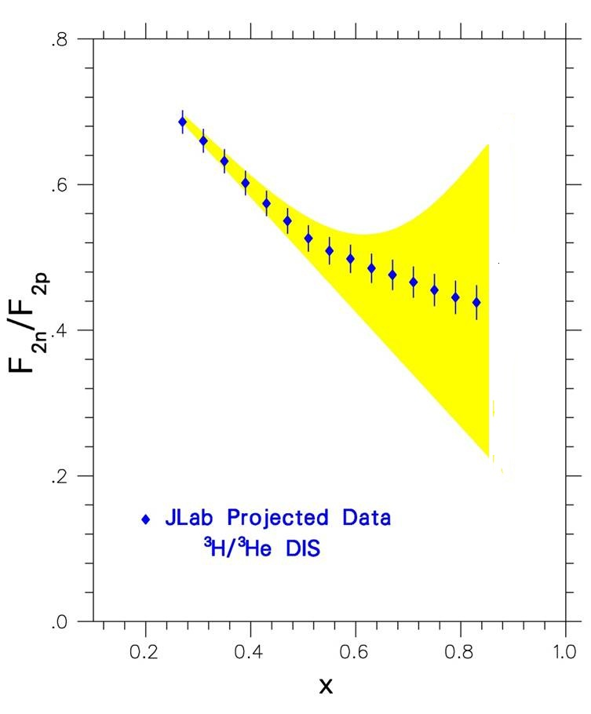
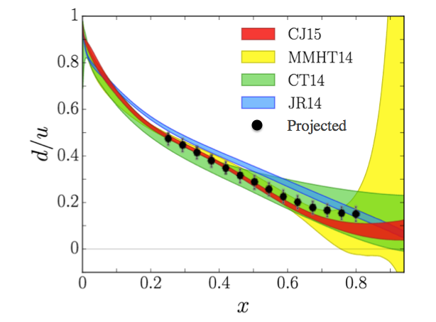
Projected JLab Hall A Data for F₂^{n}/F₂^{p} and d/u Ratios
11 GeV beam; Left and Right High Resolution Hall A Spectrometers
3H and 3He gas target system; 42 days of data taking

Slide 14
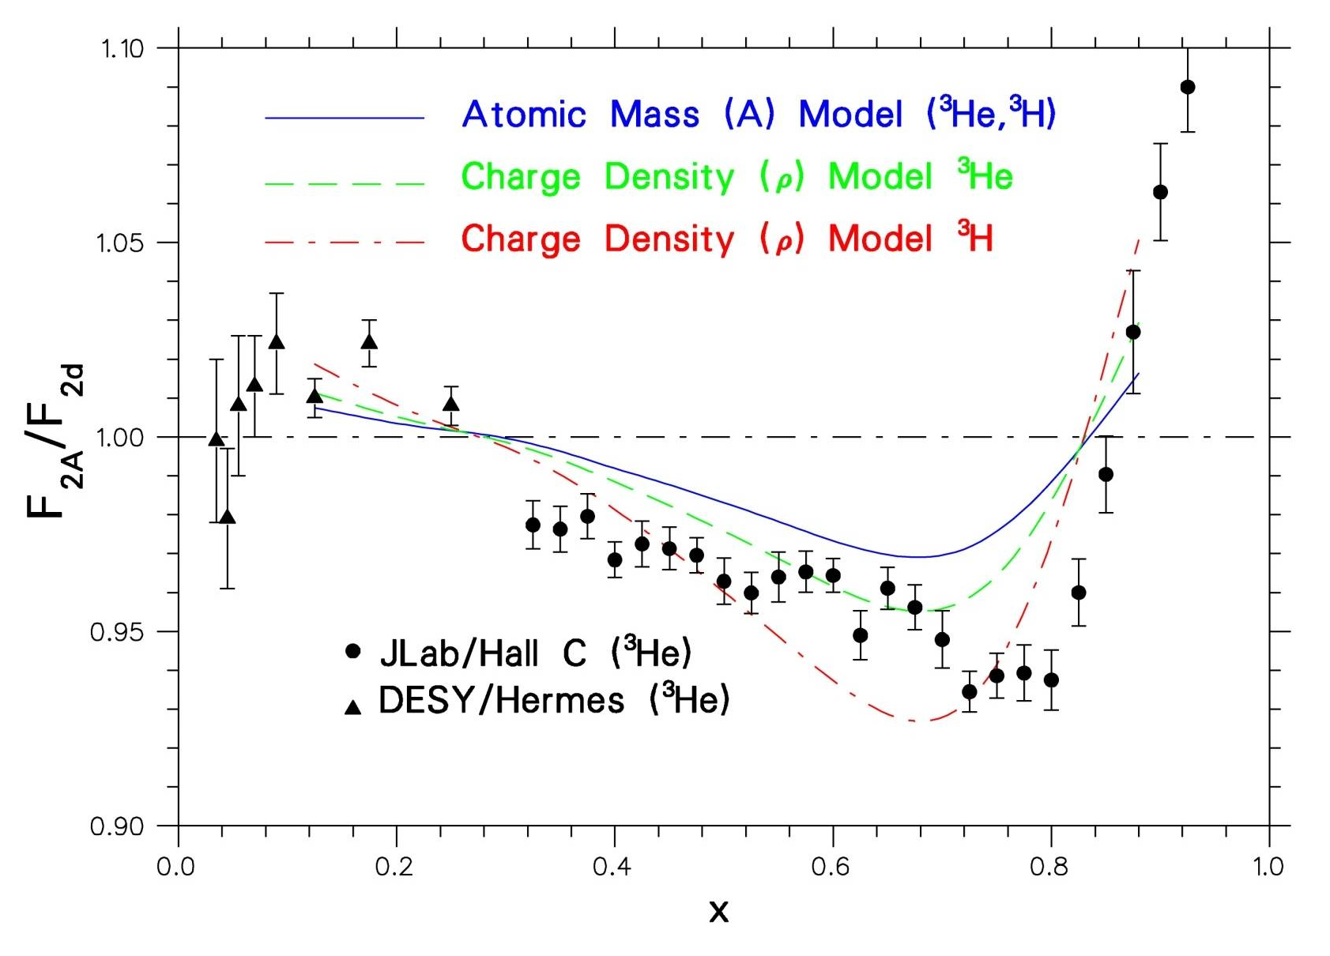
EMC Effect for A=3 Mirror Nuclei
Hall A data on ³H, ³He will be of similar precision to Hall C data

Slide 15
Summary
JLab Hall A MARATHON experiment target system has passed safety review and is currently being installed.
Experiment passed recently readiness review.
Will use the two HRS electron detection systems.
Is scheduled to take data in the fall of 2017.
Will provide doctoral thesis topics for several graduate students.
Will provide data on F₂^{n}/F₂^{p} and d/u with minimal theoretical uncertainties, and input for parton distribution parametrizations.
Will provide precision data on the EMC effect for the A=3 nuclear systems

Slide 16
An Aside
Searching for the source of BPM problems seen during the Ar40 experiment

Slide 17
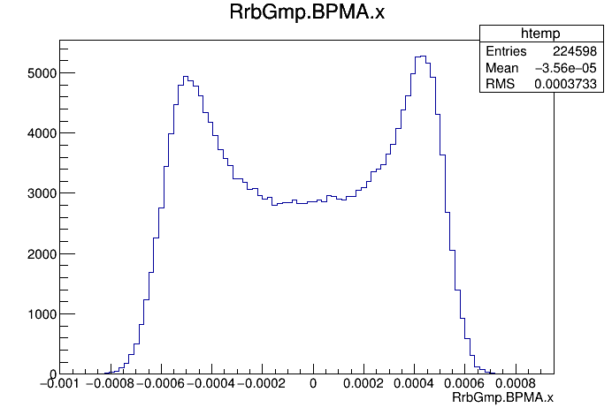
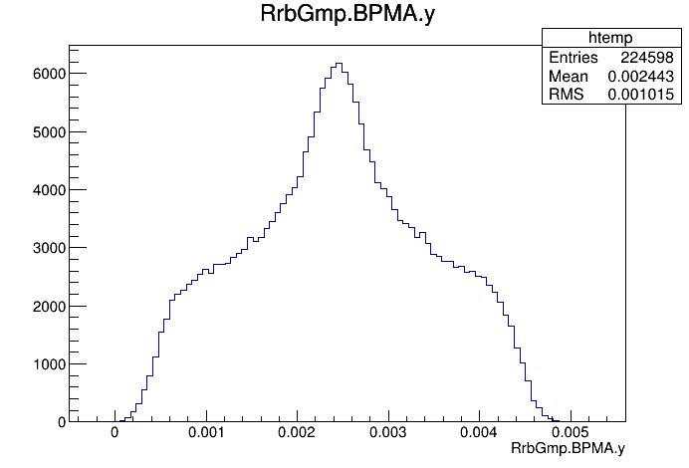
What are we seeing?
Vertical BPM does not look as it should from good beam and rastering
Horizontal BPM – correct shape
Vertical BPM – incorrect shape

Slide 18
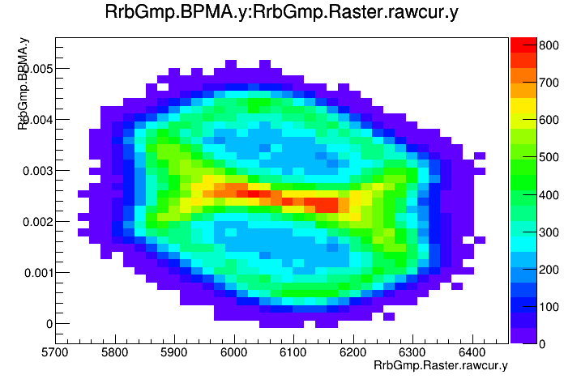
What does this mean?
Normally should see one diamond
because of the phase lag. This looks
like two overlapped diamonds
When the raster is off, we see what
appears to be a vertical jump in the beam

Slide 19
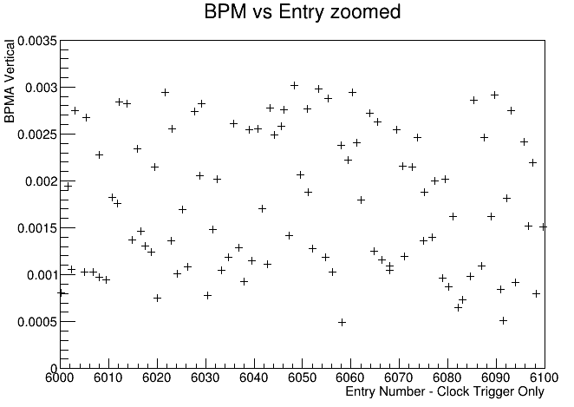
Can we find the frequency of the jump?
Looking at a large number of events,
there does not appear to be any structure
If we zoom in to view a small number
of events, we don’t see any structure

Slide 20
Can we find the frequency of the jump?
Looking at a large number of events,
there does not appear to be any structure
If we zoom in to view a small number
of events, there does not appear to be
any structure
If there is a frequency, it is faster than
the clock trigger and we can’t see it

Slide 21
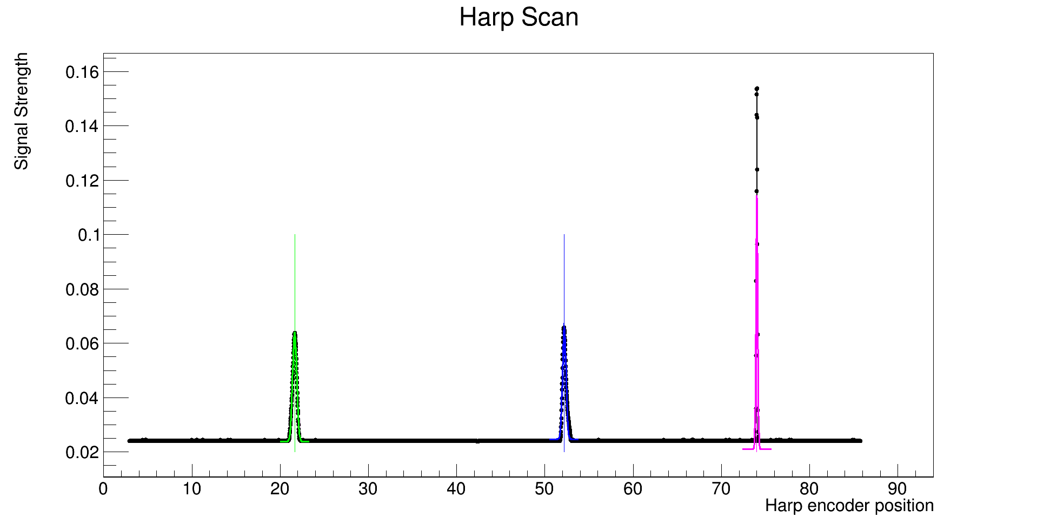
Is the beam really jumping?
The harp scan plot is inconsistent with the beam jumping
Vertical component of reconstructed
track at HRS focal plane – inconsistent with beam jumping

Slide 22
Is the beam really jumping?
The harp scan plot is inconsistent with the beam jumping
Vertical component of reconstructed
track at HRS focal plane – inconsistent with beam jumping
We don’t see the beam jumping before or after the BPM

Slide 23
Thank You！

Slide 24
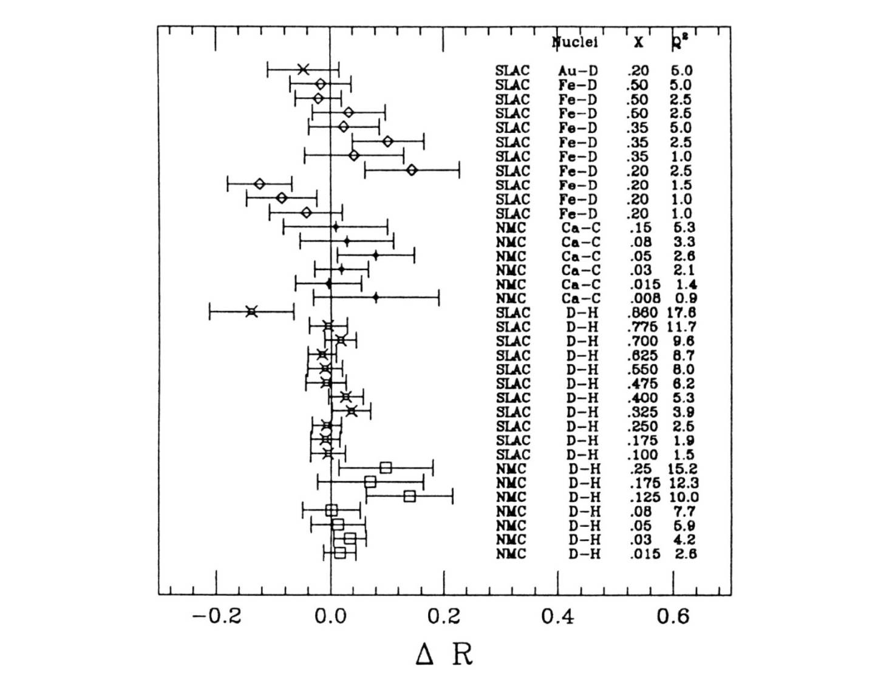
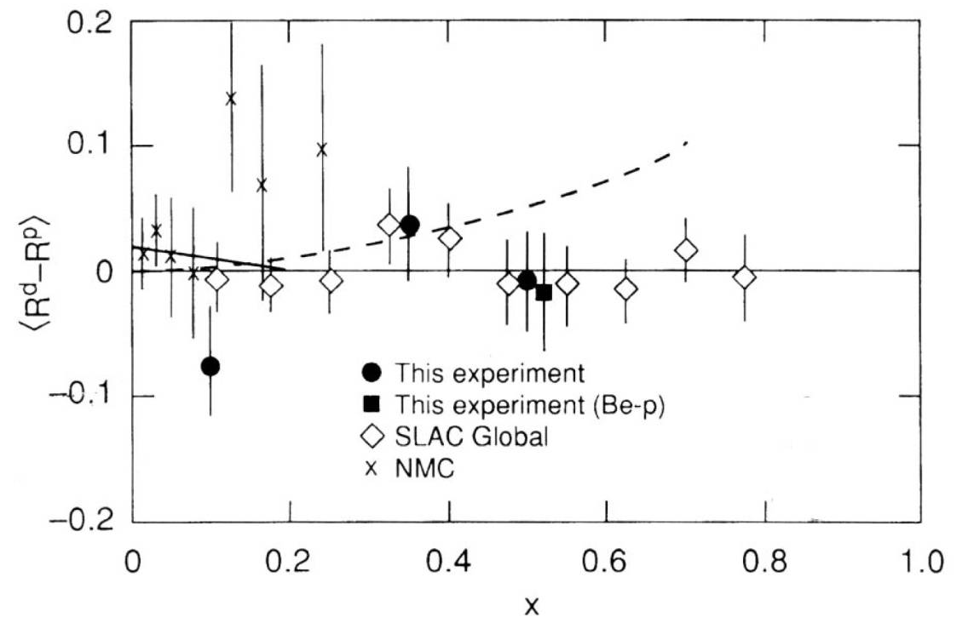
R=σ_{L}/σ_{T} Measurements
SLAC/CERN data show that the
ratio R=σ_{L}/σ_{T} is the same for all
nuclei within experimental errors
³He/³H JLab data will be of better precision
than SLAC data [wider angular range!]

Slide 25
EMC Effect
Nuclear F₂ structure function per nucleon is different than that of deuterium: large dependence on Bjorken x and mass A.
Quark distribution functions modified in the nuclear medium.
Possible explanations include:
Binding effects beyond nucleon Fermi motion
Enhancement of pion field with increasing A
Influence of possible multi-quark clusters
Change in the quark confinement scale in nuclei
Local environment and density dependence
No universally accepted theory for the effect explanation.
A=3 data will be pivotal for understanding the EMC effect.
Theorists: Ratio of EMC effect for ³H and ³He is the best quantity for quantitative check of the theory, free of most uncertainties.

Slide 26
Deep Inelastic Scattering and Quark Parton Model
Nucleon Quark Parton Model (QPM): electron scatters from the Gell-Mann/Zweig quarks interacting through massless gluons. Related formalism holds in a frame where the target moves with infinite momentum.
In the Bjorken scaling/Deep Inelastic Scattering (DIS) limit (large Q² and ν, with fixed x), the structure functions depend only on the Bjorken scaling variable x = Q²/2M ν, the fraction of the nucleon momentum carried by the struck quark.
Interpretation of structure functions in terms of quark probability momentum distributions q_{i}(x) (up, down and strange quark and antiquarks) and quark electric charges e_{i}:

Slide 27
F₂^{n}/F₂^{p} in Quark Parton Model
Assume isospin symmetry:
Proton and neutron structure functions:
Nachtmann inequality:

Slide 28
SLAC/CERN Data Interpretation in QPM
Nachtmann inequality satisfied:
For x → 0 : F₂^{n}/F₂^{p} → 1: Sea quarks dominate with:
For x → 1 : F₂^{n}/F₂^{p} → 1/4: High momentum partons
in proton (neutron) are up (down) quarks, and:
For medium and high x, safe to assume that (with d and
u denoting now quark plus antiquark distributions):

Slide 29
F₂^{n}/ F₂^{p} Deuteron Extraction Uncertainties
Theoretically, F₂^{d} is a convolution of the “free nucleon” F₂^{p} and F₂^{n} functions with the deuteron wave function. Uncertainty in knowledge of the nucleon-nucleon potential introduces a large uncertainty in the determi-nation of F₂^{n} (and F₂^{n}/F₂^{p}).
Realistic relativistic calculations also show a large sensi-tivity in the F₂^{n} extraction on the nucleon binding effects in the deuteron (W. Melnitchouk and A. Thomas).
Existence of an EMC effect in the deuteron (if the nucleon q_{i}(x) in the deuteron are different than those of the free nucleon) would alter significantly the extracted F₂^{n} value. Note: recent JLab data support the existence of the EMC effect in the deuteron!

Slide 30
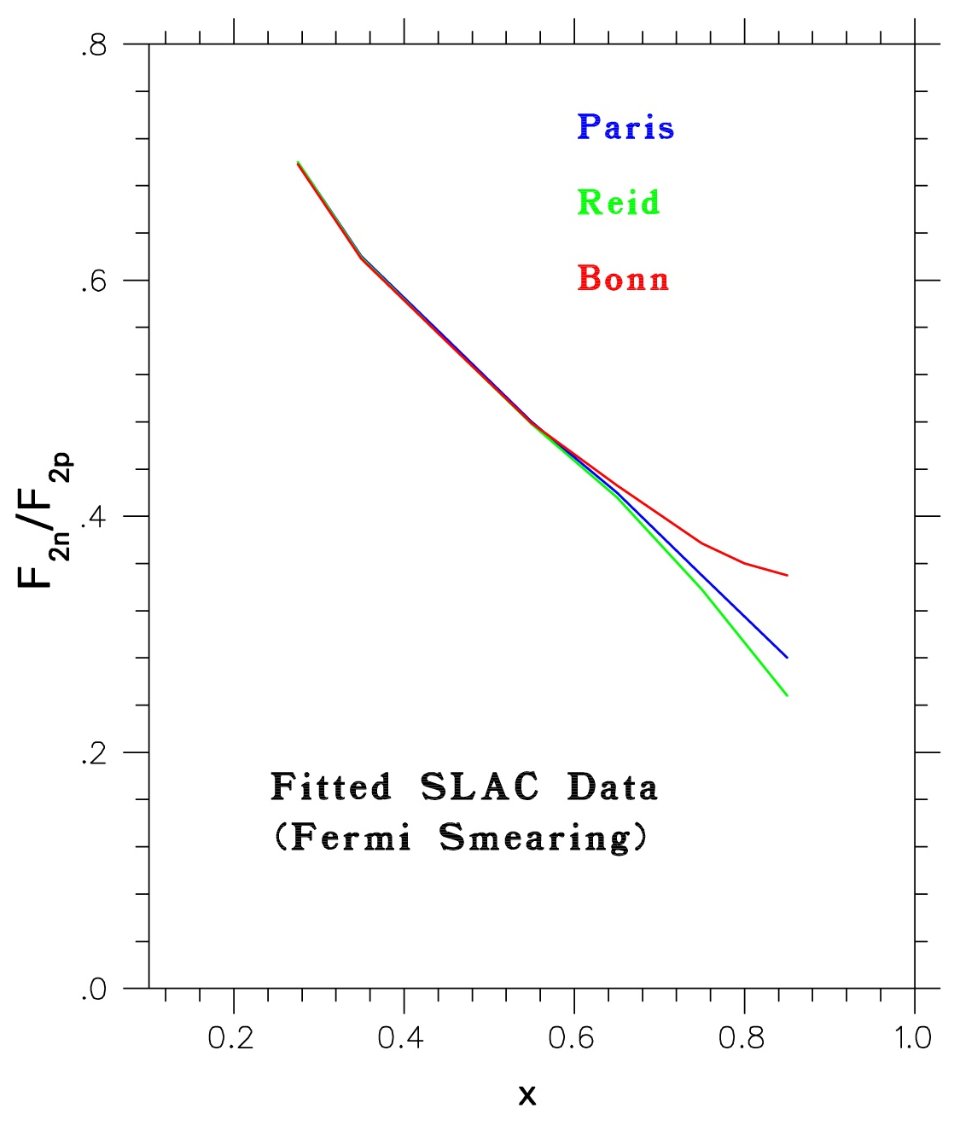
Standard analysis of F₂^{n/}F₂^{p} from
proton and deuteron data shows
large uncertainty at high-x values
depending on nucleon-nucleon
potential used.

Slide 31
Theory Overview (I)
SU(6)-breaking Diquark Model (Close/Feynman, 1970’s)
Phenomenological explanation: fall off of F₂^{n}/F₂^{p} and its x=1 limit easily explainable using SU(6) nucleon wave function (Close, 1973) or Regge theory (Feynman, 1975) and assuming that the spectator diquark configuration with total spin s=1 is suppressed relative to that with s=0.
Limit at x=1 in agreement with the SLAC/CERN data.
Constituent Quark Model (Isgur and Carl, 1980-2000)
Suppression fully understood in the hyperfine-perturbed quark model: color-magnetic hyperfine interaction generated by gluon exchange is proportional to quark spin dot products s_{i}·s_{j}. Force is repulsive(attractive) for parallel(antiparallel) spins and allows the u(x) and d(x) quark momentum distributions to be different.
Limit for x=1 in agreement with the diquark model and data.

Slide 32
Theory Overview (II)
Perturbative QCD (Farrar and Jackson, 1975)
Simple consideration of isospin and helicity structure of nucleon’s quark wave function within perturbative QCD dictates that for diquark spin alignment (s=1) only exchange of longitudinal gluons is permitted, resulting in suppression of Compton scattering amplitude, which causes the F₂^{n}/F₂^{p} fall off.
Problem: pQCD x=1 limit different than that of quark/diquark model!
QCD Counting Rules (Brodsky et al., 1995)
Early pQCD findings substantiated within first-principles calcu-lations of Counting Rules of QCD predicting the high-x behavior of quark distributions: q(x)~(1-x)^{2n-1+2Δh}, where n is the minimum number of not interacting (spectator) quarks and Δh is the difference in helicity between the struck quark and the nucleon.
Same x=1 limit as pQCD.

Slide 33
The Tritium Target System
Five-cell target structure (¹H, ²H, ³H, ³He, Al Dummy):
All cells: 25 cm long, 1.25 cm diameter, 20 µA max current
³H cell: 10 atm, 1100 Ci activity
¹H, ²H, ³He cells: 25 atm
Cells will be filled at the Oak Ridge National Laboratory.
Target will be shipped to JLab using commercial services.
System will be enclosed in secondary “sealed” containment
vessel (no reliance on fast valves).
A catastrophic leak will be vented through stack above Hall A.
Resulting emission will keep tritium levels at the JLab site
boundary below regulatory limits.
Tritium target project has passes a safety review.

Slide 34
Electron-Nucleus Inelastic Scattering
Cross section for inelastic electron-nucleus scattering [E (E’): incident (scattered) electron energy, θ: electron scattering angle, M: nuclear mass] in terms of nuclear F₁ and F₂ structure functions:
Ratio R has been measured to be the same for proton, deuteron and all other nuclear targets. Cross section ratio for two nuclei, say 3H and 3He, becomes equal to ratio of their F₂ structure functions.

Slide 35
³He and ³H Structure Functions
Nucleon structure function in nucleus A in the Impulse
Approximation: extension of deuteron model (Melnitchouk
and Thomas):
For ³He:
With isospin symmetry:
Then for ³H:
Charge symmetry breaking effects are small!

